Slide 1
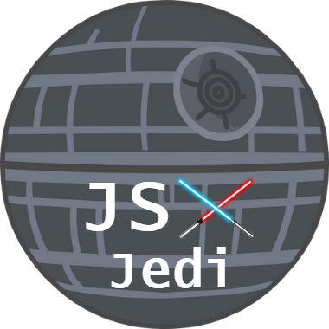
JSX Jedi
Presented by:
Andres Tostado
Miriam Avila
Nicholas Moreland
Hassan Ali
Salem Robinson

Slide 2







What we learnt
Organizing the design of a project in Figma.
Connecting an application to an API such as the platform Postman.
Connecting to Cloud services Such as Azure.
Software Development life cycle
Different programming languages such as Python, React and Ballerina.
Learned about Microservice Architecture
Learned Flask and Axios to interact with and create API services.

Slide 3
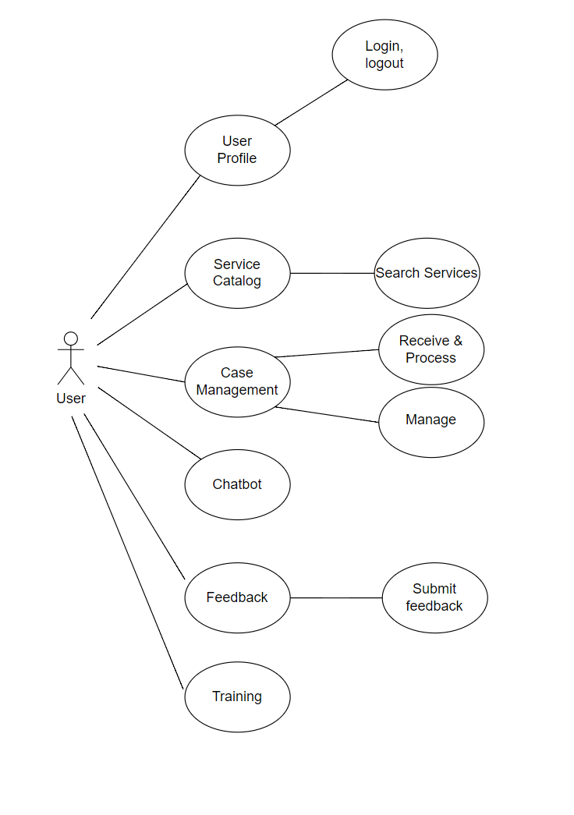
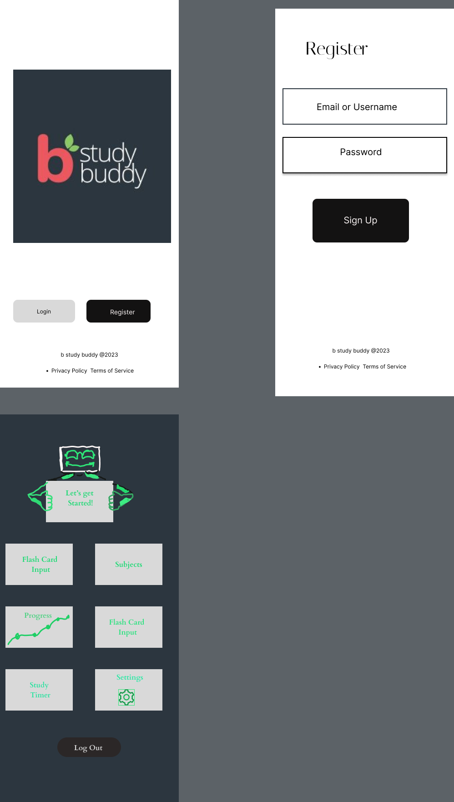
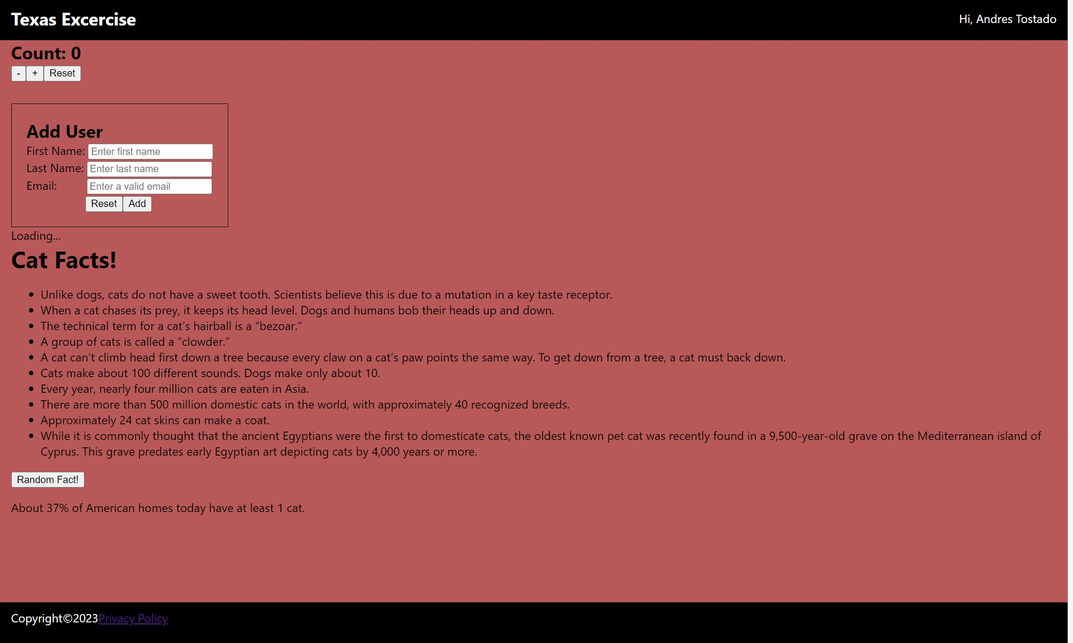
Some of our work!
Use case diagram Study Buddy Figma design Add User + Generate cat facts webpage

Slide 4


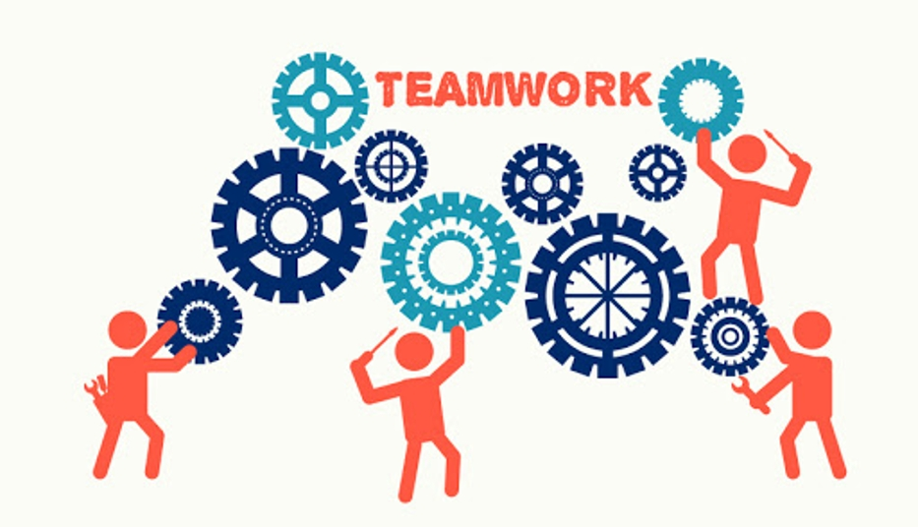
What we liked
Hands on development projects
The flexibility in the implementation and design in projects.
Ability to learn real world skills that we can use in the software development field.
The opportunity to work with a team and gain team building skills.
Great mentorship from industry professionals
Having access to professional industry tools that are used every day in the field.

Slide 5
Final Project

Slide 6
Thank You!

